Slide 1
Year 6 Welcome Meeting

Slide 2
Staff
Mrs Peano
Mrs Cooper
Mrs Austin
Mr Lee
Mrs Fillingham

Slide 3
Attendance
8:45am – Registration & Arithmetic or Grammar exercise.
8:55am – Doors close

Slide 4
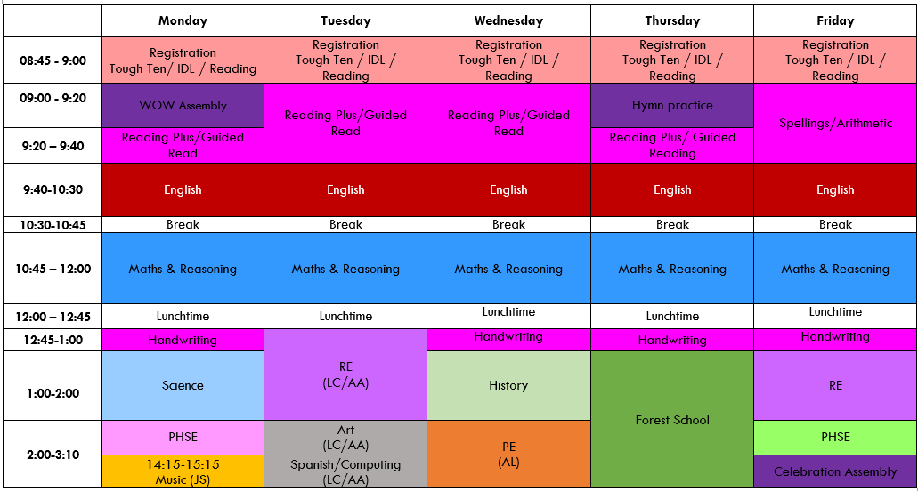

Slide 5


Slide 6
Homework
Homework will be set every Friday and due back by the following Friday.
Arithmetic/Reasoning, Grammar
Spellings (tested on a Friday)

Slide 7
Reading
With a focus on comprehension and deep understanding of the text, please read 4-5 times per week.

Slide 8
Uniform
Black trainers or shoes
Jumper or blazer
Tie
PE t-shirt and shorts or joggers/leggings

Slide 9
SATs and Boosters
SATs week 11th-14th May 2026
Reading, Grammar, Spelling and Maths (Arithmetic and Reasoning)
Boosters to commence soon

Slide 10
PGL Residential 2026
Wednesday 10th to Friday 12th June 2026

Slide 11
Secondary School
Blessed Trinity Dynamic Day – 16th Sept. 2025
Blessed Trinity Evening Talk – 17th Sept. 2025, 5:45pm at St Mary Magdalene’s
Blessed Trinity Open Evening – 9th October 2025
Apply online with LCC by 31st October 2025

