Slide 1
Year 3
Welcome Meeting
Saint Carlos Acutis
“We are all originals”

Slide 2
Staffing
Mrs Robinsworth
Miss Round
Miss Holmes
Miss Hughes
Mrs Townsend
Mrs Austin (PPA)
Mr Leigh (PE)
Mrs Gore (Forest School)

Slide 3
School Day
8:45 – School Opens
3:15 – School finished
(When the children are ready)
Punctuality
Attendance

Slide 4
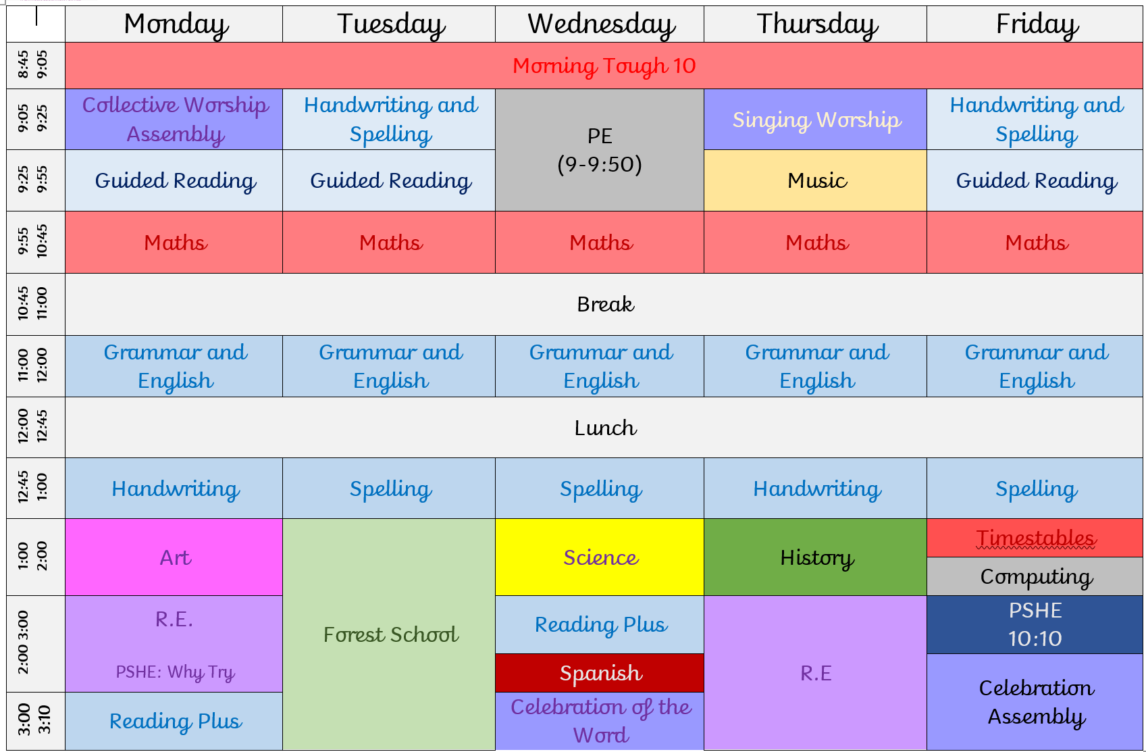
Timetable

Slide 5

Uniform
*Black shoes/Trainers
*Ties
*PE Kit
*Forest School kit
***Labels***

Slide 6

Homework
*Reading
(4-5 times a week)
*Spellings
*Emile
***Labels***

Slide 7

AOB
* Dojo
*Medical Tracker
*Open door policy

Slide 8
Questions ?

