Slide 1


Welcome Meeting
EYFS
Oscar Romero Class

Slide 2
Adults in Class​
Class Teacher
Mrs Rafique
​
Teaching Assistants​
Mrs Barlow
​
PE​
Mr Lee
Music​
Mrs Fillingham​
​

Slide 3
Class Rules
Be kind to each other.
Use kind hands and kind feet.
Put your hand up to answer a question.
Good sitting and good listening.
Use your manners.
Look after the classroom.

Slide 4
School Uniform & PE Kit​
Black school shoes (Not trainers)​
Black socks or tights​
Jumper or Cardigan​
White shirt​
Tie ​
Coat​
Small hair accessories: black, white, purple​
No nail polish to be worn. ​
Full PE kit required for every session​
Indoor PE kit : Black shorts, white t-shirt and black plimsolls​
Outdoor PE kit :plain black tracksuit bottoms/ leggings, plain black tracksuit top, trainers.(no logos)
Earrings must be removed for PE. This must be either at home or by the child.​
Hair must be tied up if shoulder length or longer. ​
PLEASE ENSURE ALL UNIFORM AND BELONGININGS ARE LABELLED

Slide 5
Water bottles
Please ensure your child has a water bottle to use in class.
No juice is allowed unless agreed by Mrs Loughran.​

Slide 6

Milk
Now your child is 5 years old they no longer receive free milk. If you would like your child to have milk then please register your child on this website.
https://www.coolmilk.com/parents/

Slide 7
Snacks & Lunches
Children will continue to receive a free piece of fruit each day .
Toast is available and payment needs to be made via the office or Parentpay.
Please ensure you choose your child’s meal options by Friday for the following week.

Slide 8
Communication
Class teachers are in their classroom from 8.45am and also at the end of the day if you wish to speak to them. Alternatively, appointments can be made directly with the class teacher or by ringing the school office.
We mostly use Class Dojo or Parent Pay to communicate information, news or events. Please ensure you are able to receive notifications by these methods.
Class Dojo
To communicate with parents individually, as a class or to the whole school.
Parents can also message Class Teachers. Queries will generally be answered between 8 – 5pm. If something is urgent please contact the school office.
To award Dojo Points to children. These are celebrated in our Celebration Assembly every Friday afternoon.
Parents can post photographs or children’s work for Class Teachers to see/ mark.
Parent Pay
Newsletters and official school letters are communicated via Parent Pay.
Parents can respond to these when requested for example if completing their child’s lunch option or a school survey.
If you have any concerns please don’t hesitate to speak to the class teacher or request a meeting with Miss Zollner.

Slide 9
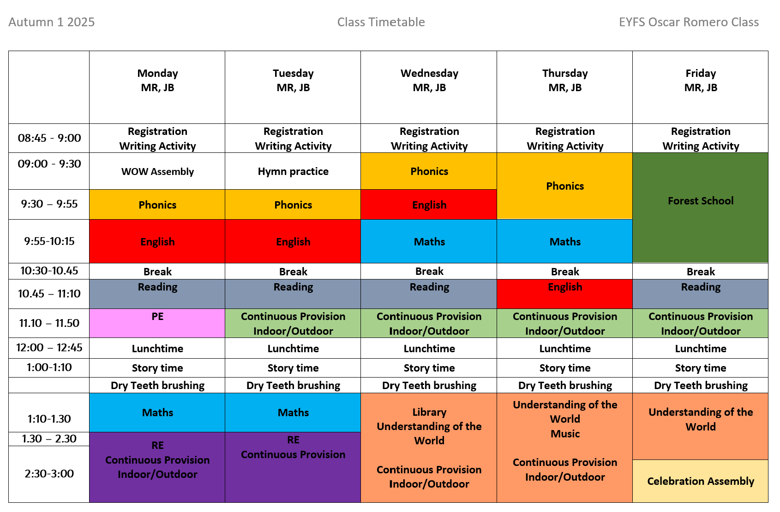

Slide 10
Homework
Reading : new reading books be sent home every Friday. Please try and read with your child 4 times a week.
Words to Learn: Your child will be sent home words to learn each week once we begin our phonics lessons.
Your child will also be sent home with a piece of either Maths, English or phonics homework each Friday. This needs to be completed in their homework books and returned to school no later than the following Wednesday.

Slide 11
Shared Celebration of Good Work
Writer of the Week - Monday
Celebration Assembly - Friday​
One child is chosen for their efforts in writing each week.
Work is displayed in the entrance for that week then kept in a ‘Celebration of Writing Book’ for all visitors to read.
The children are awarded a certificate .
One child is awarded the Headteacher Award each week. This can be for a wide range of reasons such as: positive attitude to learning, teamwork, following school rules, good / improving presentation, quality of work, being a good friend, upholding the school mission statement etc.
One child with the greatest number of Dojo Points is awarded a certificate to celebrate their achievement. These are awarded for many different reasons such as being a good role model, good behaviour, showing kindness and consideration, working hard, completing homework etc.

Slide 12
Home School Agreement
Please ensure we have two current contact numbers.
Inform us of any change in contact details immediately.
Please inform us of any changes regarding the collection of your child.
If you child’s medical needs change please inform school immediately.

