Slide 1

Year 2 Welcome Meeting
Tuesday 11th September 2025

Slide 2
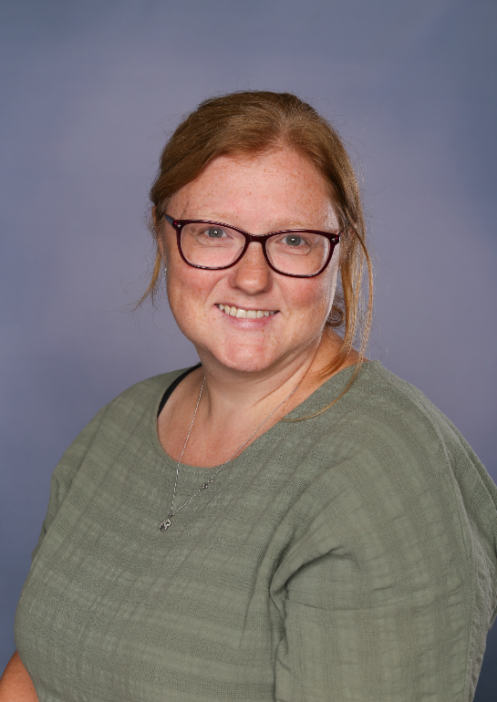
Staff
Class Teacher
Mrs Fleck
Teaching Assistant
Mrs Bottomley
Other Staff
Mr Lee, Mrs Fillingham,Mrs Gore
and Mrs Garratt
Class Teacher
Mrs Fleck
Teaching Assistants
Miss Hallett, Miss Hughes
Other Adults
Mrs Bottomley, Miss Hartley, Mrs Garratt, Mr Harrison and Coach Adam

Slide 3
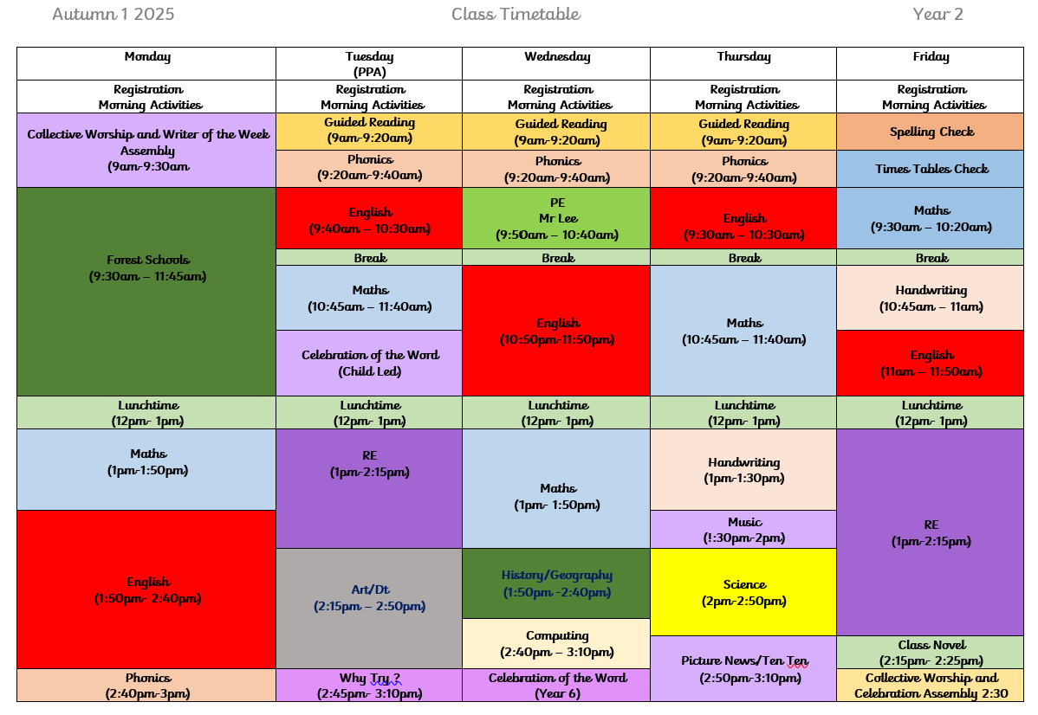

Timetable
Our Forest School day is Monday and our PE day is Wednesday.
Please send your child in with waterproofs and a change of shoes for in school.

Slide 4



Homework / Spellings
Children will be tested on their times tables.
We will start with x2 then move on to x10 and x5.
Weekly times table tests will take place on a Friday.
Spellings will be sent out each half term.
Test will take place on a Friday
You can find a copy on the website, on Dojo and a paper copy.
Homework will be sent out each half term.

Slide 5


Reading
Reading books will be changed daily.
Children need to hand their reading books in first thing in a morning.
Why read at home?

Slide 6
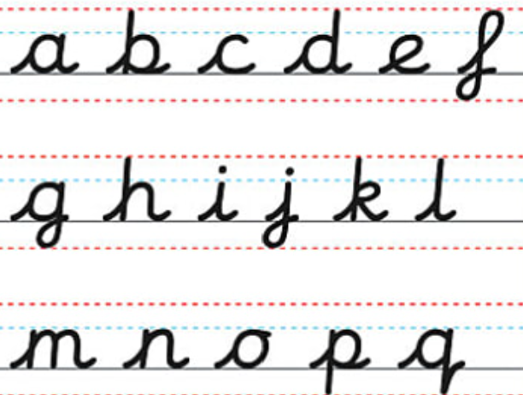
Handwriting
We will be having a big push on handwriting this year.
Children will do handwriting practise weekly. We will start by learning the correct formation with the aim of all children using joined handwriting in the summer term.

Slide 7

Class Expectations
We will show respect and love to one another.
We will use our manners at all times
We will move sensibly around the classroom and when moving around school.
We will put up our hands and listen to others.
We will respect our friends.
We will look after our equipment and keep our classroom tidy.
We are independent learners.

Slide 8



Rewards
Star of the day and Star Jar
Head teacher
Award
Dojo Points

Slide 9
Important Information
Please ensure children are only bringing in WATER in the water bottles.
Black school shoes or trainers.
Studs (these must be removed for PE days).
Inform the office if a child is absent.
Please label your child’s PE kit, jumpers and cardigans.
School lunches.
I am available for contact either on the door or via Dojo and will try my best to reply as soon as possible during working hours.

Slide 10

Any questions?

